Slide 1
Chapter 9
Error Detection and Correction
Types of Errors
Detection
Correction
WCB/McGraw-Hill
© The McGraw-Hill Companies, Inc., 1998

Slide 2
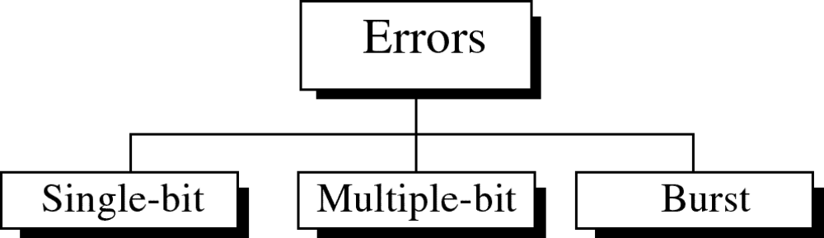
Figure 9-1
WCB/McGraw-Hill
© The McGraw-Hill Companies, Inc., 1998

Slide 3
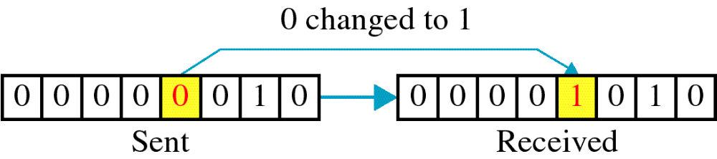
Figure 9-2
Single-bit error
WCB/McGraw-Hill
© The McGraw-Hill Companies, Inc., 1998

Slide 4
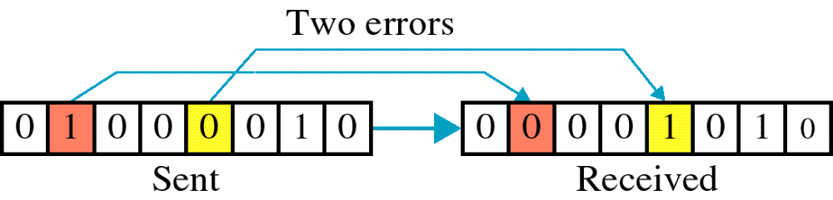
Figure 9-3
Multiple-bit error
WCB/McGraw-Hill
© The McGraw-Hill Companies, Inc., 1998

Slide 5
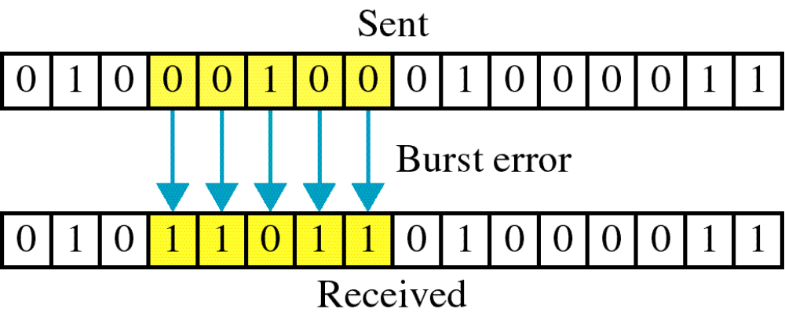
Figure 9-4
Burst error
WCB/McGraw-Hill
© The McGraw-Hill Companies, Inc., 1998

Slide 6
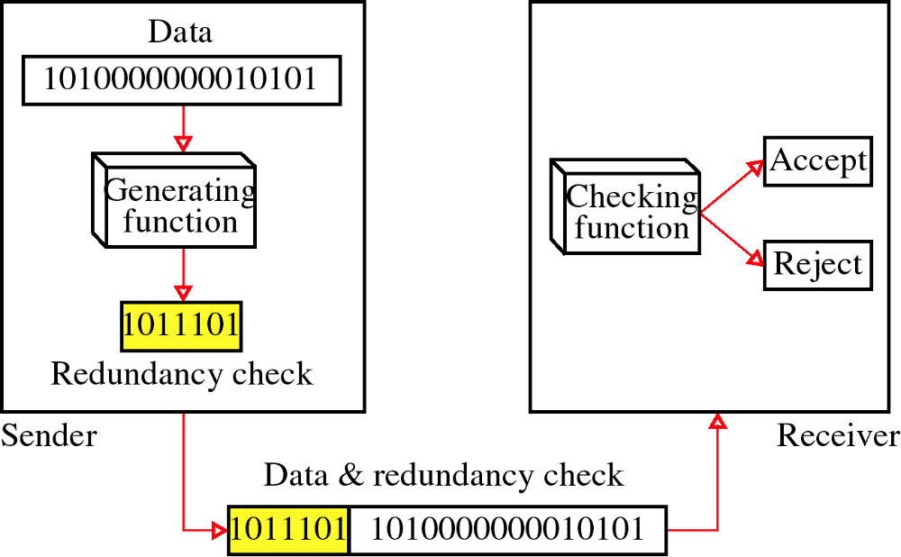
Figure 9-5
Redundancy
WCB/McGraw-Hill
© The McGraw-Hill Companies, Inc., 1998

Slide 7
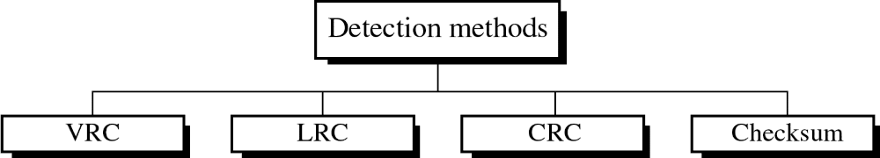
Figure 9-6
WCB/McGraw-Hill
© The McGraw-Hill Companies, Inc., 1998

Slide 8
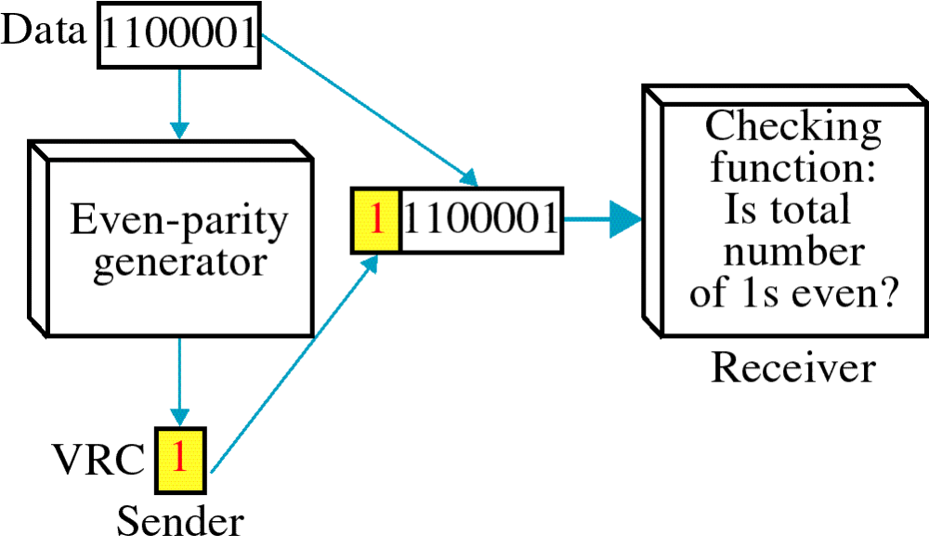
Figure 9-7
VRC
WCB/McGraw-Hill
© The McGraw-Hill Companies, Inc., 1998

Slide 9
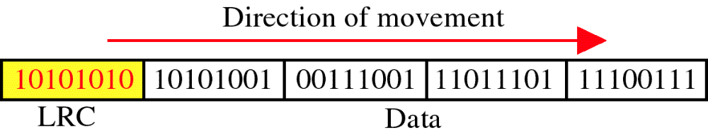
Figure 9-8
LRC
WCB/McGraw-Hill
© The McGraw-Hill Companies, Inc., 1998

Slide 10
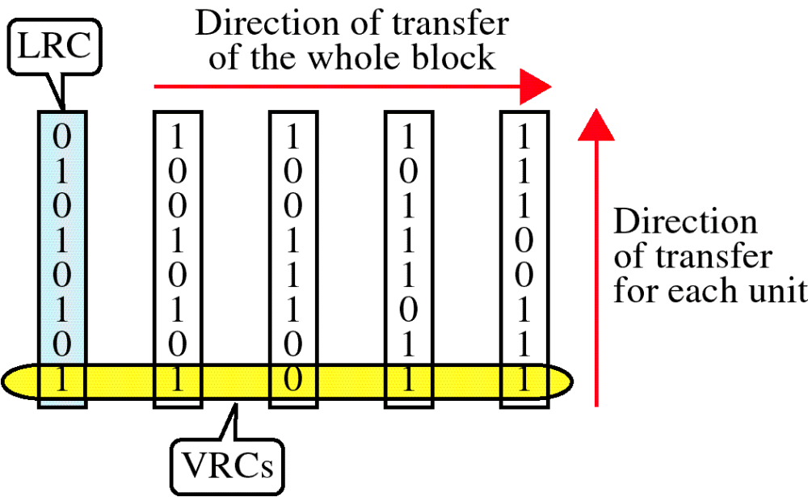
Figure 9-9
VRC and LRC
WCB/McGraw-Hill
© The McGraw-Hill Companies, Inc., 1998

